Slide 1
The Delicate Balance of Senior Protection and Investor Autonomy
February 28, 2024
This presentation is prepared by Bressler, Amery & Ross, P.C. as a general informational service and should not be construed as, and does not constitute, legal advice on any specific matter, nor does its dissemination create an attorney-client relationship.

Slide 2
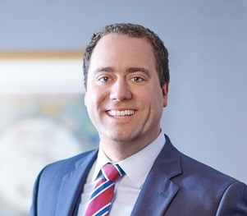
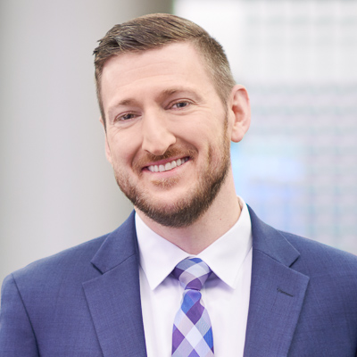
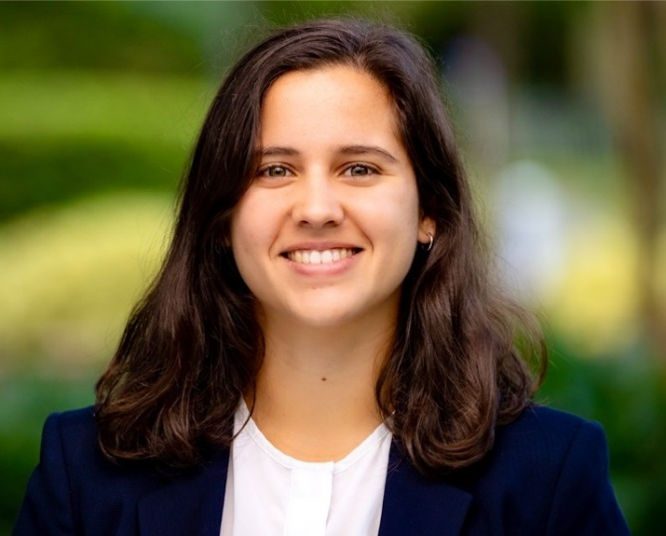
Andrew Egan
Principal | New Jersey
aegan@bressler.com
Who
We Are
Logan S. Fisher
Principal | New Jersey | New York
lfisher@bressler.com
Audrey Rizk
Associate | New York
arizk@bressler.com

Slide 3
Overview
TODAY'S DISCUSSION
What is senior/vulnerable investor financial exploitation?
Laws, rules and regulations protecting seniors/vulnerable investors.
What can I do? Best practices and practical tips

Slide 4
What Is Senior/Vulnerable Investor Exploitation
Section One

Slide 5
What is Exploitation?
Generally speaking, “financial exploitation” means:
the wrongful or unauthorized taking, withholding, appropriation, or use of a person’s funds or securities; or
any act or omission by a person, including through the use of a power of attorney, guardianship, or any other authority regarding a Specified Adult, to:
obtain control, through deception, intimidation or undue influence, over a person’s money, assets or property; or
convert the person’s money, assets or property.

Slide 6
Who is Protected?
“Specified Adults” under FINRA Rules:
State laws:
65 and older
18 and older who firm reasonably believes has a mental or physical impairment that prevents them from protecting own interests
60 and older (varies state to state); and
18 and older who have diminished physical or mental capacity
Senior Safe Act:
65 and older

Slide 7
Demographics: The Senior Population Swells
Nearly one in five U.S. residents will be 65 or older in 2030¹
Baby Boomers control over 70% of the nation’s disposable income²
Baby Boomers’ financial assets will peak at $26 trillion in 2029³
Billions are lost each year to financial exploitation of seniors and vulnerable persons
1- Source: Sandra L. Colby and Jennifer M. Ortman, “The Baby Boom Cohort in the United States: 2012 to 2060,” United States Census Bureau (May 2014).
2- Source: Baby Boomer Report 2015, U.S. News & World Report.
3 - Source: Val Srinivas and Urval Goradia, “The future of wealth in the United States,” Deloitte Center for Financial Services (Nov. 9, 2015).

Slide 8
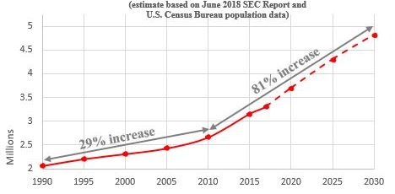
Annual Occurrences of Senior Financial Exploitation

Slide 9
Elder Financial Abuse SAR Filings by Securities Firms

Slide 10
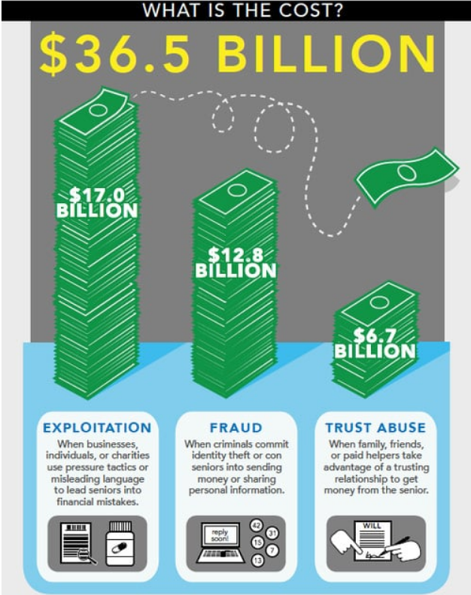
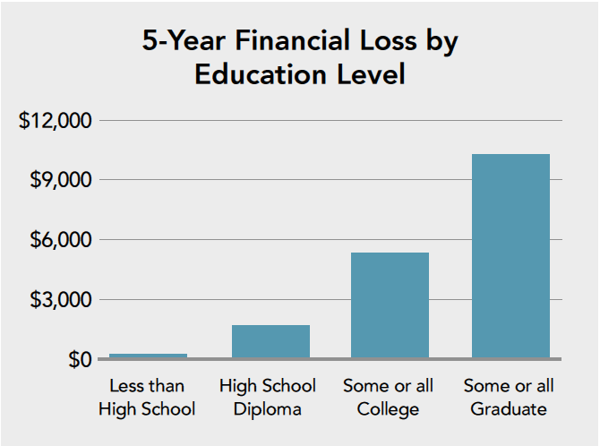
Source: http://documents.truelinkfinancial.com/True-Link-Report-On-Elder-Financial-Abuse-012815.pdf

Slide 11
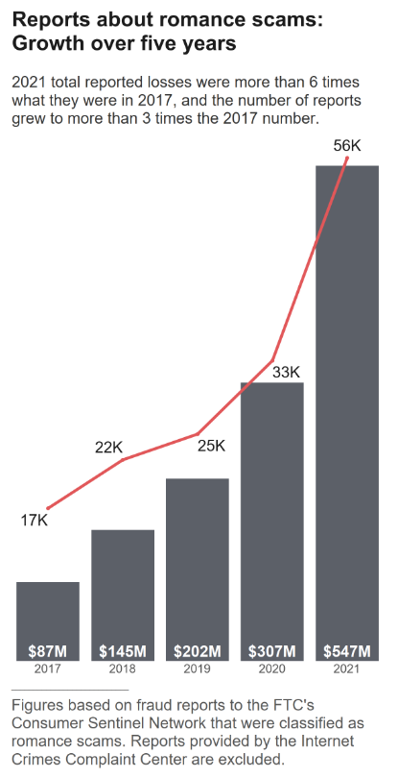
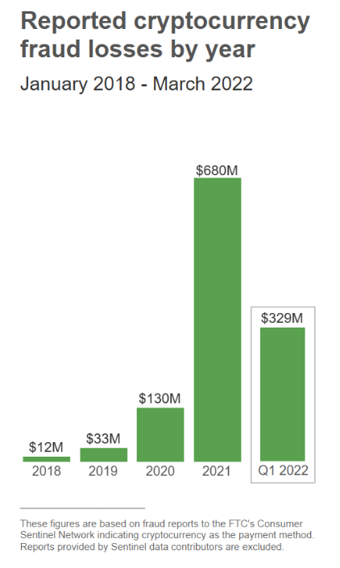
Recent Popular Scams
https://www.ftc.gov/news-events/data-visualizations/data-spotlight/2022/02/reports-romance-scams-hit-record-highs-2021
https://www.ftc.gov/news-events/data-visualizations/data-spotlight/2022/06/reports-show-scammers-cashing-crypto-craze

Slide 12
90%
of the bad actors
are close to their victims
(primary risk is not financial advisors)

Slide 13
Financial
Exploitation of Seniors
MISTREATMENT BREAKDOWN
Family members – 57.9%
Adult children = 24.6%
Friends and neighbors – 16.9%
Paid home care aides – 14.9%
Guardians and POAs create risk for clients and firms
Source: Peterson, J., Burnes, D., Caccamise, P., Mason, A., Henderson, C., Wells, M., & Lachs, M. (2014). Financial exploitation of older adults: a population-based prevalence study.
Journal of General Internal Medicine, 29(12), 1615–23.

Slide 14
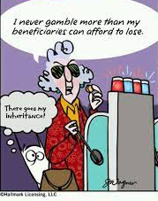
What Is Diminished Capacity?
Can be at any age
May be temporary
Questionable decisions do not necessarily equate to diminished capacity
Increased studies on the aging brain and the impact on financial decisions

Slide 15
Making decisions inconsistent with history or stated goals
Interest in “get rich quick” schemes
Inability to understand important or basic aspects of the account
Memory loss
Disorientation
Change in appearance
Inability to pay bills or multiple bills at the same time, bouncing checks
Repeated calls and/or repeated resetting of online account access passwords
Diminished Capacity
RECOGNIZED SIGNS
For a comprehensive treatment of red flags, see NASAA, A Guide for Developing Practices and Procedures for Protecting Senior Investors and Vulnerable Adults from Financial Exploitation (September 2016); FINRA Regulatory Notice 07-43, Senior Investors (September 2007).

Slide 16
Dramatic, unexplained shifts in investment style or unusual transactions
Sudden withdrawals or changes in amount/frequency of withdrawals
Family/friends/new acquaintances who pay extraordinary interest in assets/belongings
Suspicious signatures or documents
Abrupt changes in trusted contact, beneficiary or estate planning documents
Red Flags Indicating Possible Exploitation

Slide 17
Other
Common Indicators
“Unnatural” Gifts | Isolation/Secrecy | New Professionals | Control of Finances
Caregivers, Friends, Neighbors, Service Providers | Cutting Off Access by Phone, Email & In Person | Attorneys & Accountants | Power of Attorney Joint Account Ownership
Disproportionate/ Uneven Gifts Among Children w/o Reason | Preventing Visits (Threats to Call Police, Intimidation, “Mom Needs her Rest”, Monitoring) | Doctors | Signing Checks for Person
Inter Vivos: Gifts so Large they Threaten Financial Security | Major Changes in Lifestyle – No Interest in Holidays, etc. | Clergy | Control of Statements/ Checkbooks/Cards
Loans, Particularly Undocumented | Living with One Child (Often Coupled With Threats to Put Elder “In a Home”) | Financial Advisors

Slide 18
Laws, Rules and Regulations Protecting Seniors
Section Two

Slide 19
Senior Safe Act - exploitation reporting and training
State Adult Protective Services (APS) Statutes (all 50 states)
State financial exploitation statutes (30 states and counting)
FINRA’s (trusted contact, report and hold)
Senior & Vulnerable Client Rules and Laws

Slide 20
The Senior Safe Act
The law encourages (but does not require) firms to disclose suspected financial exploitation by providing limited immunity with regard to such disclosures so long as firms provide training compliant with the Act

Slide 21
Senior Safe Act:
Reporting & Training
Reporting
Training
Reports may be made to a broad array of “covered” agencies, including financial regulatory agencies, federal agencies such as the SEC, SROs, law enforcement and adult protective services
Must be provided as soon as reasonably practicable and within one year from the date of employment/affiliation with the financial institution.
Must instruct about how to identify and report financial exploitation.
Client privacy/integrity.
Tailored to job responsibilities of the employee.

Slide 22
All states have laws related to how and when to report elder abuse
Some states require reporting by all persons
Other states permit reporting by all persons
States have different protocols and time frames for reporting
Good faith reporting triggers immunity from civil/criminal liability
APS
Statutes

Slide 23
State Financial Exploitation Statutes
Required or permissive reporting to state APS, securities commissioner and/or other agencies
Permissive temporary hold of suspicious disbursements/transactions
Permissive third party disclosures
Required training provisions
Holds are allowed only where the firm confronts:
A senior or vulnerable investor and exploitation
Diminished capacity alone is not enough to warrant a disbursement hold

Slide 24
New Jersey
Senior – Anyone 65 or older, or anyone 60 of older who is a patient, resident or client of a senior care facility.
APS Statute
Permissive for any person to report to the County Adult Protective Services Provider if the person has reasonable cause to believe that a vulnerable adult is subject to abuse, neglect, or exploitation
For Broker-Dealers and Investment advisors → Mandatory Reporting, to either:
NJ Bureau of Securities
Local APS

Slide 25
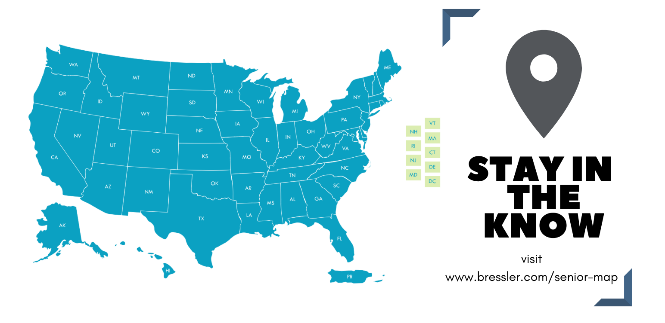
Bressler’s Interactive 50 State Survey

Slide 26
FINRA’s Rules
Rule 4512
Rule 2165
Rule 3241
Trusted Contact Persons
Financial Exploitation of Specified Adults
Registered Person Being Named a Customer’s Beneficiary or
Holding a Position of Trust

Slide 27
Amended
Rule 4512
Firms must disclose to the customer, in writing, that they are authorized to contact the TCP and disclose certain information to:
Address possible financial exploitation
Confirm the specifics of customer’s current contact information
Confirm the customer’s health status
Confirm the identity of any legal guardian, executor, trustee, or holder of a POA
As otherwise permitted by FINRA Rule 2165
TRUSTED CONTACT PERSONS
Firms must make reasonable efforts to obtain the name and contact information for a trusted contact person

Slide 28
Hold can be extended 10 business days where the evidence supports the suspicion
Hold can be extended an additional 30 business days if firm has reported the matter to a state regulator, agency or court
State regulator, agency or court may extend or terminate the hold
Within 2 business days, firm must notify TCP and all persons authorized to transact business on the account
Amended
Rule 2165
TEMPORARY HOLD
Permits firm to place initial 15 business day temporary hold on securities transactions and disbursements if the firm has a reasonable belief of financial exploitation

Slide 29
Best Practices and
Practical Tips
Section Three

Slide 30
Local police department – perform a “wellness check”
Other local governmental agencies (e.g., health & human services)
Interpleader
An equitable proceeding brought by a stakeholder to have a court determine the ownership rights of multiple claimants
Petition for guardianship or conservatorship
Other Legal Tools & Remedies

Slide 31
Other Resources
NASAA http://serveourseniors.org/
FINRA https://www.finra.org/industry/senior-investors
FINRA’s Securities Helpline for Seniors
844-57-HELPS (844-574-3577)
SIFMA Senior Investor Protection Toolkit
Bressler’s Seniors Map https://www.bressler.com/senior-map
AARP Foundation’s ElderWatch

Slide 32
BIRMINGHAM, ALABAMA
2001 Park Place North • Suite 1500
Birmingham, AL 35203 • Phone: 205.719.0400
FORT LAUDERDALE, FLORIDA
200 East Las Olas Boulevard • Suite 1500
Fort Lauderdale, FL 33301 • Phone: 954.499.7979
MIAMI, FLORIDA
200 South Biscayne Boulevard • Suite 2401
Miami , FL 33131 • Phone: 305.501.5480
FLORHAM PARK, NEW JERSEY
325 Columbia Turnpike • Suite 301
Florham Park, NJ 07932 • Phone: 973.514.1200
NEW YORK, NEW YORK
17 State Street • 34th Floor
New York, NY 10004 • Phone: 212.425.9300
CHARLOTTE, NORTH CAROLINA
525 North Tryon Street • Suite 1600
Charlotte, NC 28202 • Phone: 980.301.9525
AUSTIN, TEXAS
500 W 2nd Street • Suite 1900
Austin, TX • Phone: 512.532.3541
DALLAS, TEXAS
16475 Dallas Parkway • Suite 555
Dallas, TX • Phone: 972.733.2900
HOUSTON, TEXAS
3700 Buffalo Speedway • Suite 1020
Houston, TX 77098 • Phone: 713.403.6400
WASHINGTON, D.C.
1100 Connecticut Avenue • Suite 810
Washington, DC 20036 • Phone: 301.793.1370

